Slide 1
Pillars Of FPD Growth
Full HD 3D
Smart TV (Internet Ready)
Notes:
The FPD sales is witnessed to grow many fold in the coming years,,
The 3D Evolution & Smart TV revolution is changing the way consumer feel and experience TV,,
These technologies will be the Pillars of FPD Growth

Slide 2
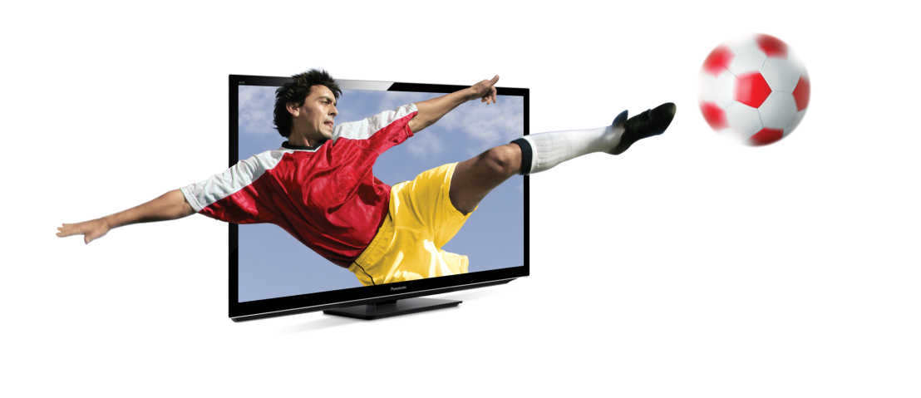
Global 3DTV Demand
M units
FlatTV
32%
25%
3DTV
17%
8%
1%
CY
Source: Display Search
Notes:
Before I go into details of 3D TV Evolution,
let me touch upon how we see the Global FPD market will develop.
As the Flat Panel market demand becomes stable,
we see that there are 2 key factors for driving the market.
These are 3D and IPTV.
By 2014, we foresee that 3DTVs will make up over 30% of the flat TV market.
This is equal to 90 million sets Globally.
=CLICK=

Slide 3
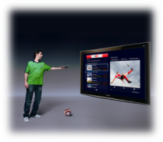
Global Internet TV Demand
M units
FlatTV
43%
39%
35%
Smart TV
28%
12%
CY
Source: Display Search
Notes:
Similar can be said for IPTVs and in 2014, over 40% of all FPDs will be IPTVS.
This is equal to 120 million sets.

Slide 4
2011
Standard Year of 3DTV and Internet TV
Notes:
We can say that the year 2011 will be the Standard base creating year for both the 3D and IPTV based FPD TV’s,,
In India we have been a bit slow in adopting the technological trends and after the global launches of products
It used to be launched in India after a time lag, but now this is not the situation any more,,
Now major MNC’s we look at are investing a huge amount of money in India as the Indian economy is amongst the very few
Which is stable and growing,, Good examples Global launches happening in India,,
are with us,, Etios launched by Toyota,, Panasonic was no where behind,, last year we launched an LCD TV ((((Sounds For India)))) designed specifically keeping in mind the Indian Consumer,,
So coming to the point Now the latest technology is available to the Indian consumers almost parallel to their global launch,,
May it be 3D or the Internet ready technology,,

Slide 5
3D Technology
&
Its Evolution
Notes:
What is 3D Technology?? And how are 3D Images created??
Are constant questions asked within ourselves??
I will try to briefly take you through the creation, recording and broadcast of 3D Images

Slide 6
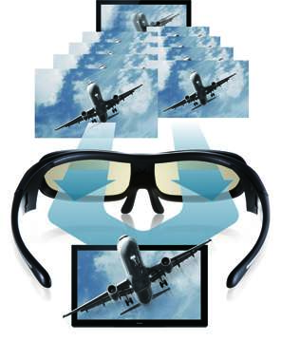
3D Science
Adjusting left and right parallax changes depth and the intensity of leaping effects.
Science of Vision –
2D Image : When the left eye and the right eye watch the same image simultaneously a 2D image is created,, in which depth cannot be visualized
3D Image : When the left eye is made to watch the left eye image and after a delay the right eye is made to watch the right eye image,, a stereoscopic 3D image is formed in the brain,, image so constructed in the brain has depth,, as we see in day to day life
Notes:
How is a 3D Image Created in Our brain –
When do we see a 2D Image : When the left eye and the right eye watch the same image simultaneously a 2D image is created,, in which depth cannot be visualized
How do we see a 3D Image : When the left eye is made to watch the left eye image and after a delay the right eye is made to watch the right eye image,, a stereoscopic 3D image is formed in the brain,, image so constructed in the brain has depth,, as we see in day to day life

Slide 7
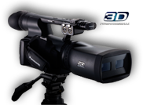
3D Science
Adjusting left and right parallax changes depth and the intensity of leaping effects.
Capturing & Recording 3D Images–
Notes:
How is a 3D Image Created in Our brain –
We need to shoot content in 3D if we want to view it in a 3D TV (although there are technology that takes a 2D film and turns it into 3D).
Basically you have to shoot the same scene from 2 cameras, and make sure that they are in sync and have a fixed distance between them.
Several companies are working on professional 3D movie cameras, that have 2 lenses built-in in the same camera, which obviously makes everything easier.

Slide 8
3D EVOLUTION
Anaglyph
Oldest Method
Polarized (Passive)
Used In Theatres
Active Shutter
Used in
TV
Auto-Stereoscopic
No Glasses Required
Notes:
The 3D Technology has passed 4 stages of Evolution,, 3 of them are currently being used:
- Anaglyph 3D : Probably the easiest way to make 3D images is to separate the right and left image using colors. The image has two color "layers", and you separate the layers using glasses that has blue/red lenses (or cellophane paper, in the cheapest glasses). This is called Anaglyph 3D, it's cheap and easy to do as you don't need a new TV and the glasses are very cheap. The problem is that you lose colors in the image. It simply looks bad.
A Polarized 3D uses a polarizing filter on the image so the left and right images each has a different polarization. You use passive glasses that filter the right image for each eye. This technique is popular in the cinemas using two synchronized projectors.
Active Shutter : The new breed of 3D TVs and projectors make use of a simple idea - you display images for the left and right eye alternatively - once the image for the left eye, and once for the right. Now all you have to do is wear glasses that block each eye in sync with the display, and you get 3D. Active Shutter 3D glasses main advantage is that the image looks great - just as they look in 2D on the same display.
Active-3D is costly, though
- Auto Stereoscopic : Auto-Stereoscopic displays display different pixels to each eye, using optics (lenses or barriers) to direct the correct pixels to each eye. The nice part is that you don't need to wear any glasses to experience the 3D image! But there are many problems with these new kinds of technologies. Basically there is just one location you can be in order to view the 3D correctly (just one viewpoint).

